Slide 1
Updating ELT teachers’ digital literacy with
‘Prompting Quotient’ in the age of generative AI
Jiajin Xu
National Research Centre for Foreign Language Education
Beijing Foreign Studies University

Slide 2
Updating ELT teachers’ digital literacy with
‘Prompting Quotient’ in the age of generative AI
Jiajin Xu
National Research Centre for Foreign Language Education
Beijing Foreign Studies University

Slide 3
Updating ELT teachers’ digital literacy with
‘Prompting Quotient’ in the age of generative AI
Jiajin Xu
National Research Centre for Foreign Language Education
Beijing Foreign Studies University

Slide 4
Updating ELT teachers’ digital literacy with
‘Prompting Quotient’ in the age of generative AI
Jiajin Xu
National Research Centre for Foreign Language Education
Beijing Foreign Studies University

Slide 5
Key points
AI for education
Teachers’ digital literacy
Update teachers’ digital literacy with Prompting Quotient
AI-empowered case scenarios for personalised learning
Concluding remarks

Slide 6
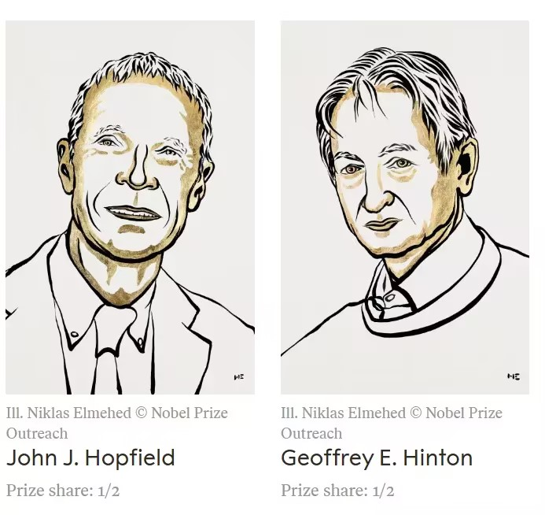


Slide 7
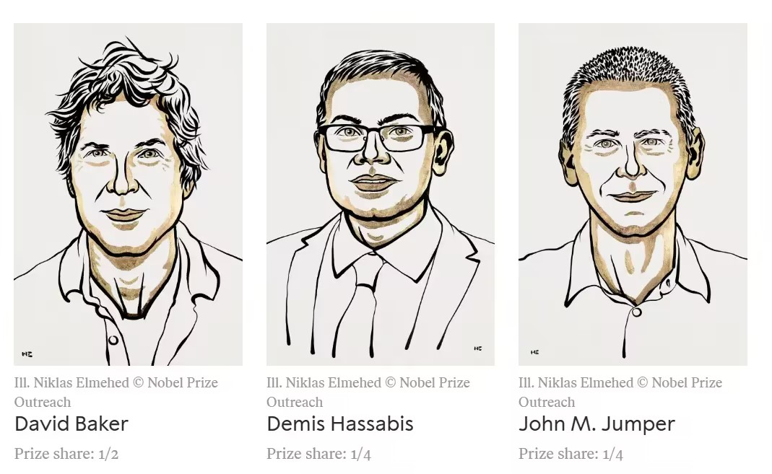

Slide 8

UNESCO (2023)

Slide 9

UK Department for Education (2024)

Slide 10
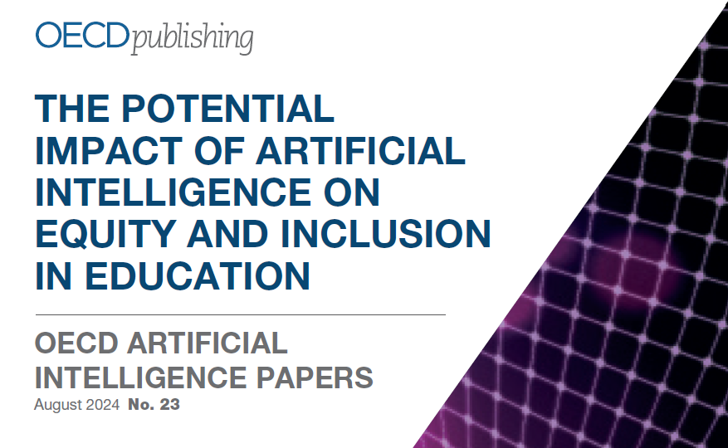
Notes:
The Organisation for Economic Co-operation and Development (OECD)

Slide 11

Digital Promise (2024)
Notes:
Digital Promise, a global nonprofit organization

Slide 12


Slide 13

UNICEF (2024)

Slide 14
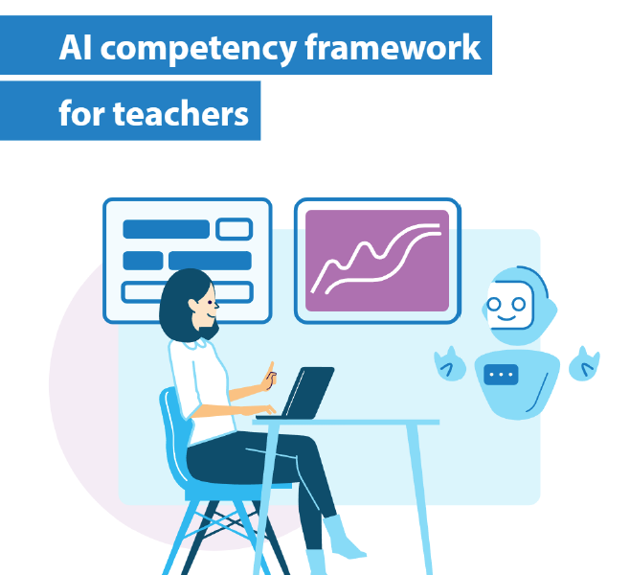
UNESCO (2024)

Slide 15
UNESCO framework
Five core AI competency domains for teachers
Human-centered mindset
Ethics of AI
AI foundations and applications
AI pedagogy, and
AI for professional development

Slide 16
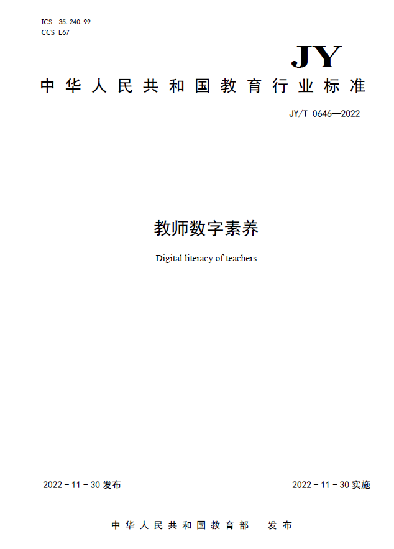
China’s National Standard for Digital Literacy of Teachers
Issued on 30 November 2022 by the MoE of China.

Slide 17
The standard perfectly stopped at the dawn of GenAI.
ChatGPT was first released on November 30, 2022.

Slide 18
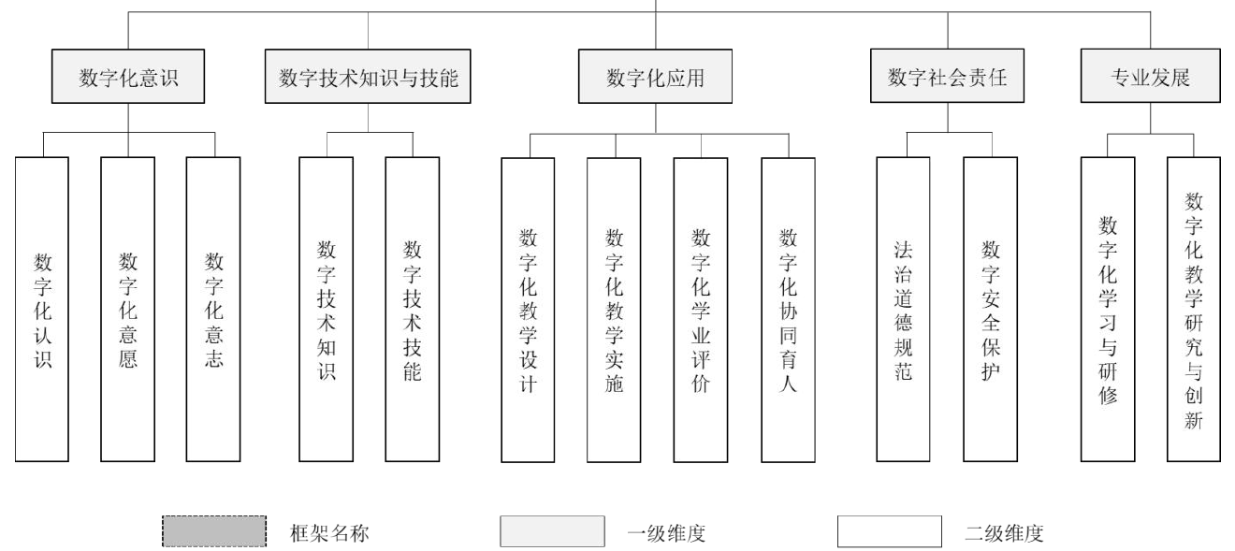
1st & 2nd tier dimensions of teachers’ digital literacy

Slide 19
5 key 1st tier dimensions for teachers’ digital literacy
Digital awareness
Digital technology knowledge and skills
Digital application
Digital social responsibility
Professional development

Slide 20
Tier 2 dimensions:
3. Digital application
Digital teaching design
Digital teaching implementation
Digital academic assessment
Digital collaborative education

Slide 21
Tier 3 dimensions
Conduct analysis of learning situations
Acquire, manage, and create digital educational resources
Design digital teaching activities
Create blended learning environments
Use digital technology resources to support the organisation and management of teaching activities
Use digital technology resources to optimise teaching processes
Use digital technology resources to provide individualised guidance
Select and apply new tools for collecting evaluation data
Apply data analysis models to analyse academic data
Achieve visualisation and interpretation of academic data
Foster students' digital literacy
Use digital technology resources for moral education
Use digital technology resources for mental health education
Use digital technology resources to promote home-school collaboration

Slide 22
Interim summary
In China, teachers’ digital literacy was officially established as a national standard in 2022.
However, the rapid advancement of generative AI necessitates an update to this standard.

Slide 23
This talk

Slide 24
The last mile problem
Previous documents appear to be geared more towards educational administrators and researchers rather than classroom teachers.
This talk focusses on the practical applications of GenAI to enhance ELT, and takes personalised ELT as a starting point and a goal.

Slide 25
In practice
Prompt design is a keystone for effectively using generative AI.
Writing prompts is considered a ‘Low Floor, High Ceiling’ task.

Slide 26
Prompting Quotient
A new component to teachers’ digital literacy:
Prompting Quotient (PQ) (Xu, et al. 2024: 227).
Analogous to IQ and EQ,
PQ refers to AI users’ proficiency in crafting prompts when working with chatbots as teaching tools.

Slide 27
Key components of Prompting Quotient
A solid foundation in ELT pedagogy;
The ability to identify and address challenges arising from ELT practice;
The skills for writing effective prompts as well as competence in prompt-mediated human-AI interaction; and
The capacity to generate innovative pedagogic solutions through the use of prompts.
Notes:
Successful prompt engineering in ELT requires more than just technical skills. It demands:
1) A strong foundation of general knowledge, and understanding of ELT pedagogy or pedagogical content knowledge;
2) The acumen to identify and address key challenges in ELT practice; and
3) The ultimate goal of prompt engineering in ELT is to facilitate effective learning, with a particular focus on creating personalised learning experiences for students.

Slide 28
Xu, et al. (2024: 227)

Slide 29
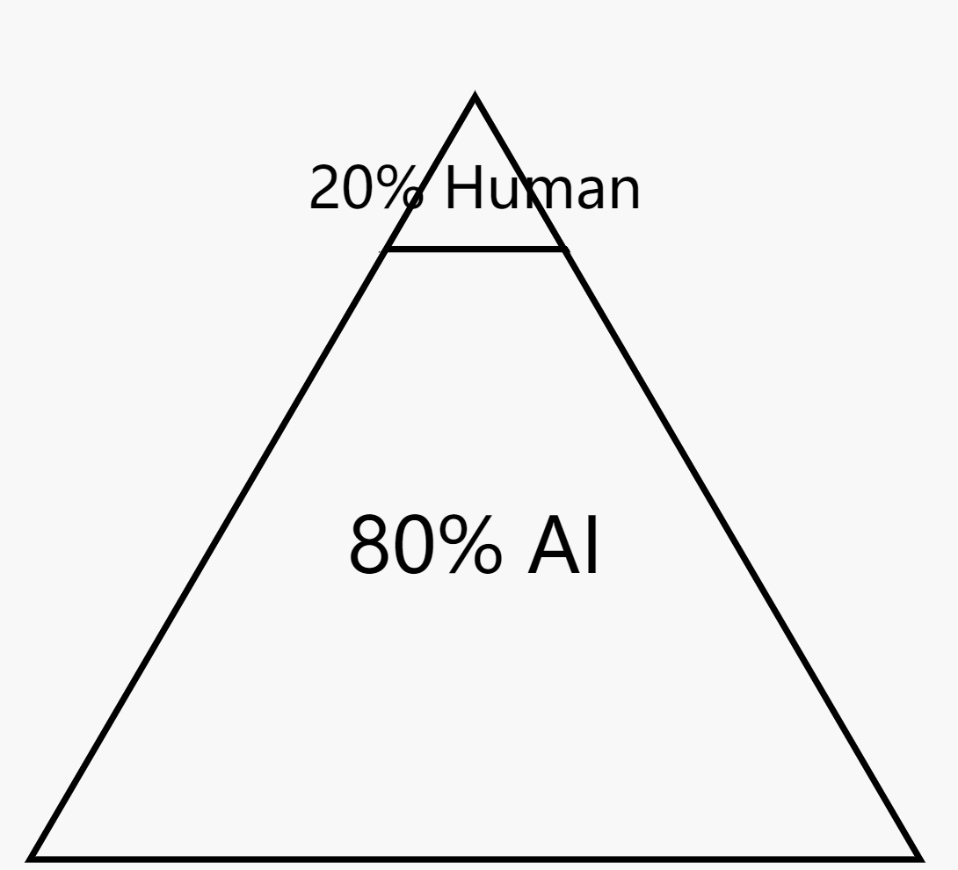
Human-AI collaboration: The 20/80 rule
V. Pareto, 1896, 1906; Joseph Juran, 1941
(generated by Claude 3.5 Sonnet)

Slide 30
The vital role of human teachers in their 20% task
Ensure the alignment with teaching objectives and curriculum, e.g., personalised learning challenges.
Verify the factual and ethnical correctness of the generated content.

Slide 31

Applications of LLMs in FLT and Research
Reprinted nine times since its publication in March 2024.
ca. 10,000 estimated copies.

Slide 32
Learning-centeredness & personalised learning
Cases of ELT scenarios that highlight the applications of teachers’ digital literacy through prompt engineering.
At its heart, learning-centered pedagogy aligns with the principles of personalised learning.

Slide 33
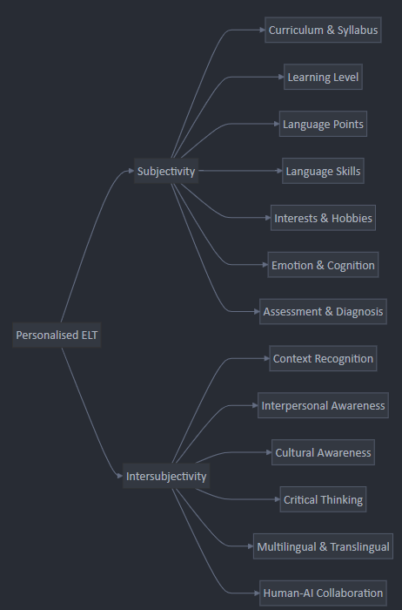

Slide 34
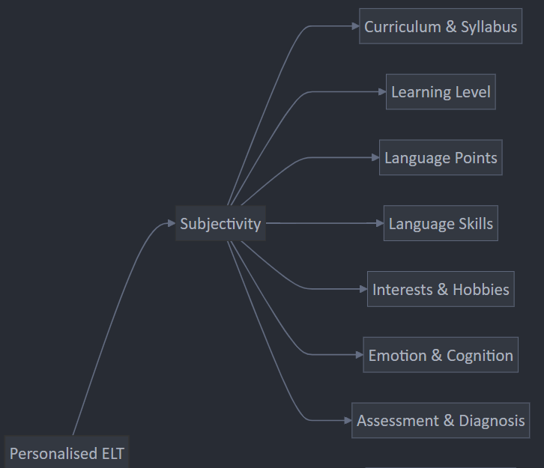

Slide 35
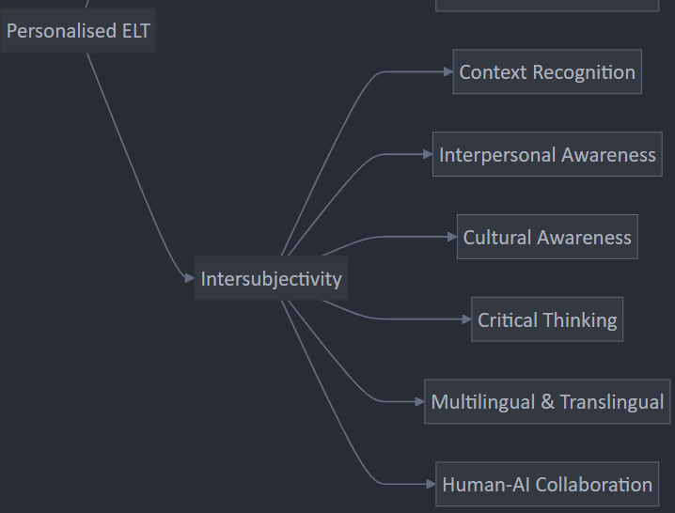

Slide 36
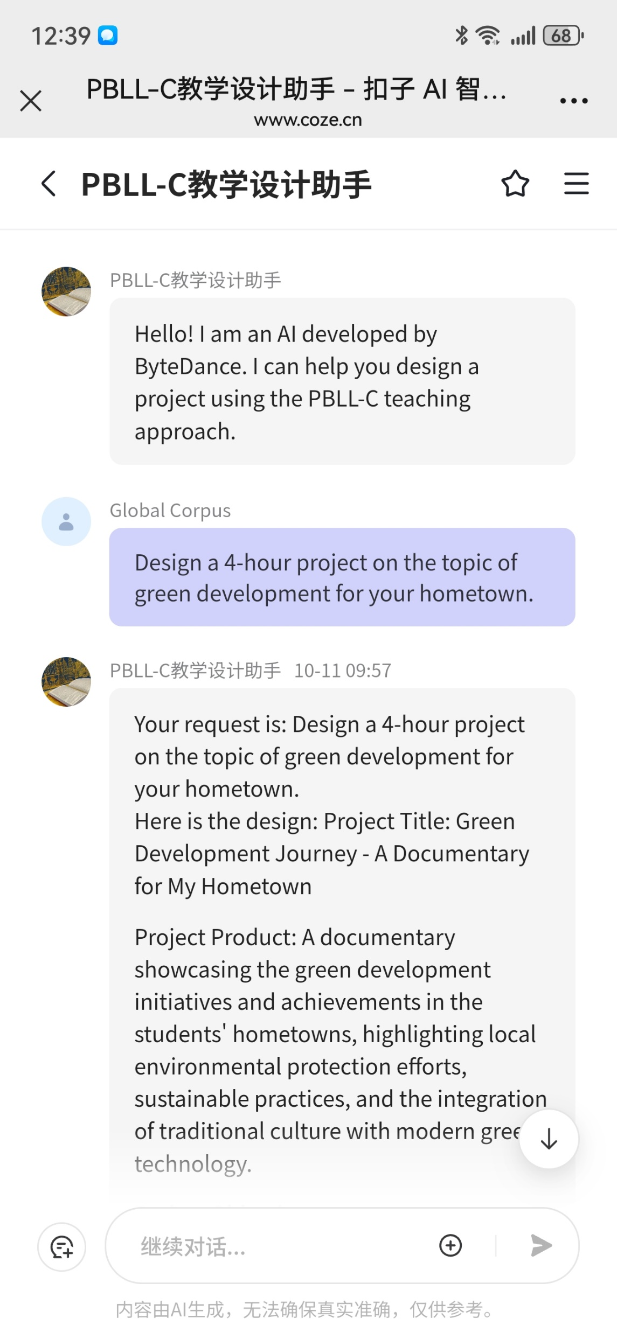
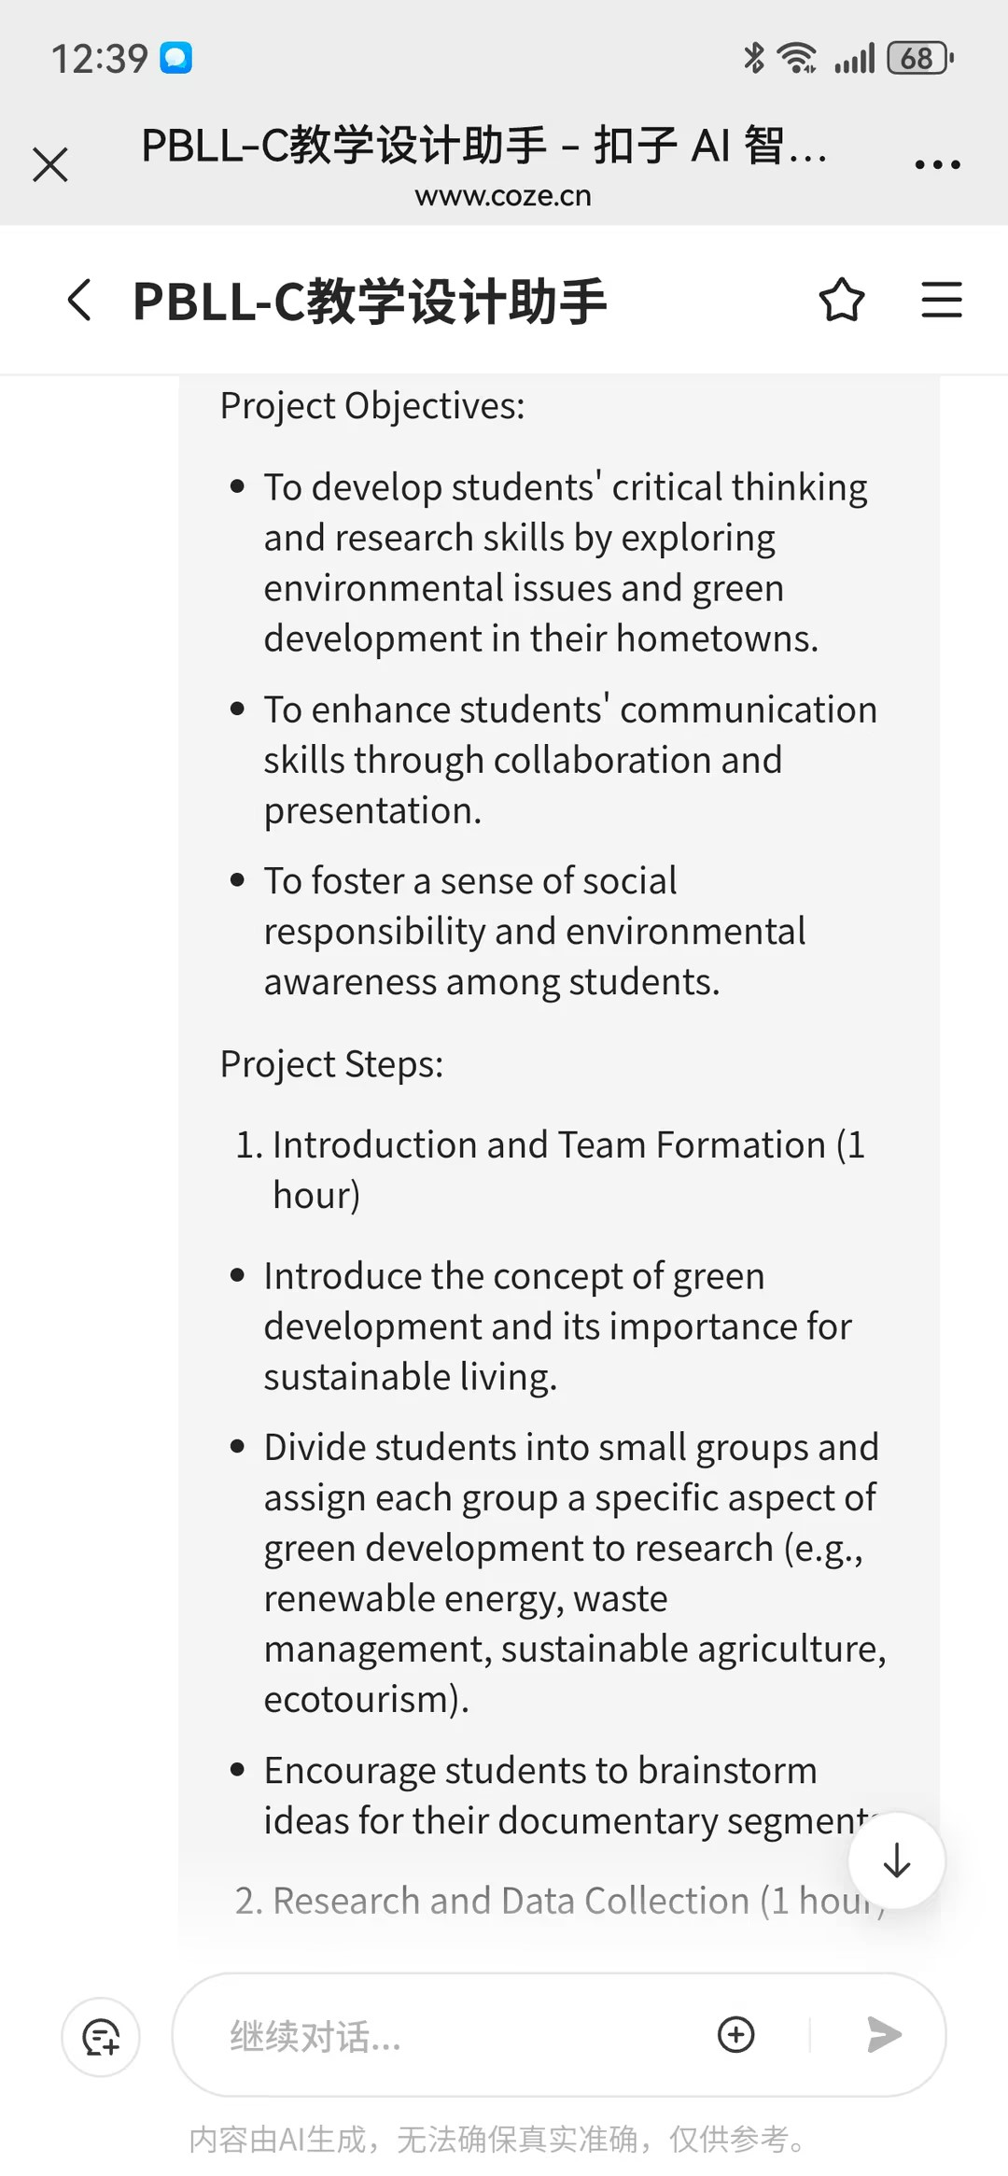
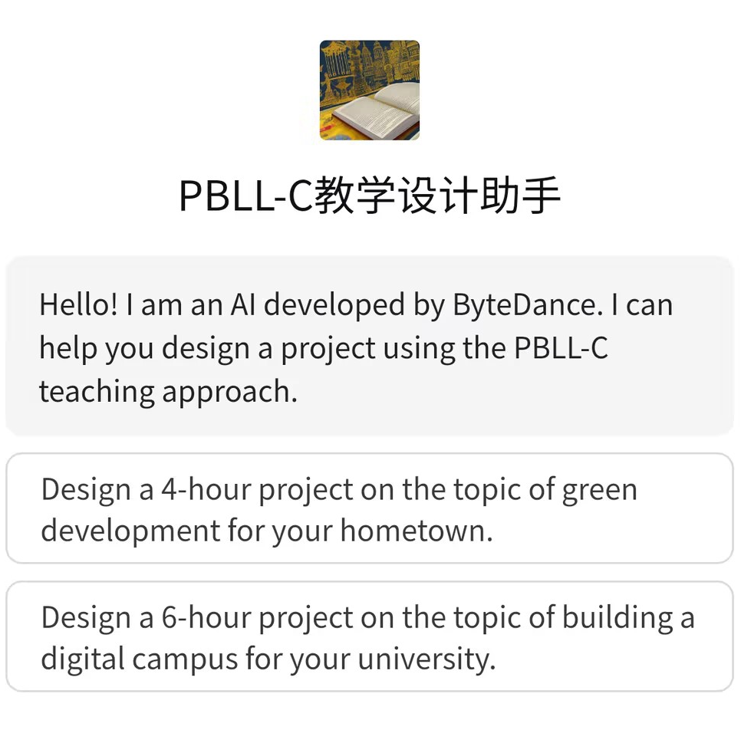

Personalised curriculum & syllabus with AI
PBLL-C teaching design assistant by Prof. Haixiao Wang, Nanjing University, China

Slide 37
Personalised curriculum & syllabus with AI
PBLL-C teaching design assistant by Prof. Haixiao Wang, Nanjing University, China

Slide 38
Personalised curriculum & syllabus with AI
Two other prominent Chinese ELT approaches,
The Production-Oriented Approach, by Qiufang Wen
The Xu (Continuation)-Based Approach, by Chuming Wang
have integrated AI into their teaching designs and applications.

Slide 39
Customised materials for level, topic, and skills
Please generate a passage and corresponding exercises on a given topic for the specified level student group. Author: ZY
Theme: <title>
Difficulty level: <level of learners>
Required words: <list of words>
Write a text of 150-250 words about the given theme for the specified level of learners. Your text should incorporate the required words, along with three multiple-choice questions, three true/false questions, three fill-in-the-blank questions, and three matching questions based on the text and the required words. Ensure that all questions have clear and accurate answers.

Slide 40

From Zero to Hero: A Volunteering Journey
It was five days before the opening ceremony of Beijing 2022 Winter Olympics. Under the clear blue sky of Yanqing, the snow mountains shone brightly, and the snowflakes danced lightly on the ski field. I was so excited that I could hardly wait.
I worked as an Olympic Family Assistant at the chief landing center for International Olympic Committee (IOC) and other international sports federations. On that day, I was assigned to assist Mr. C, the chief snowmaking expert, who used to be a National Alpine Skiing Center staff member. ……

Slide 41
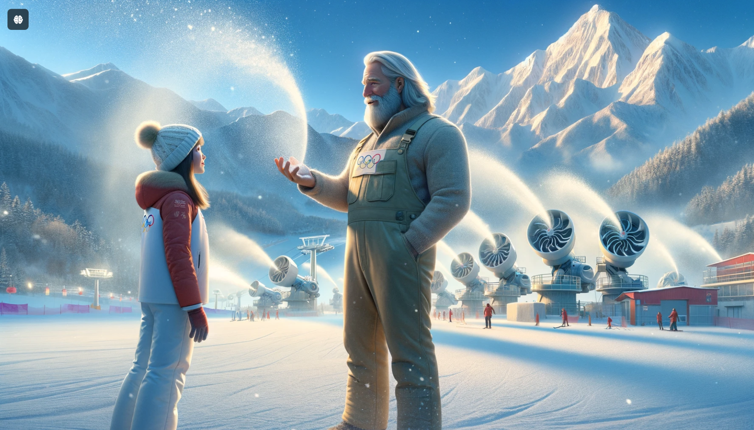
Created for visual-spatial learning style

Slide 42
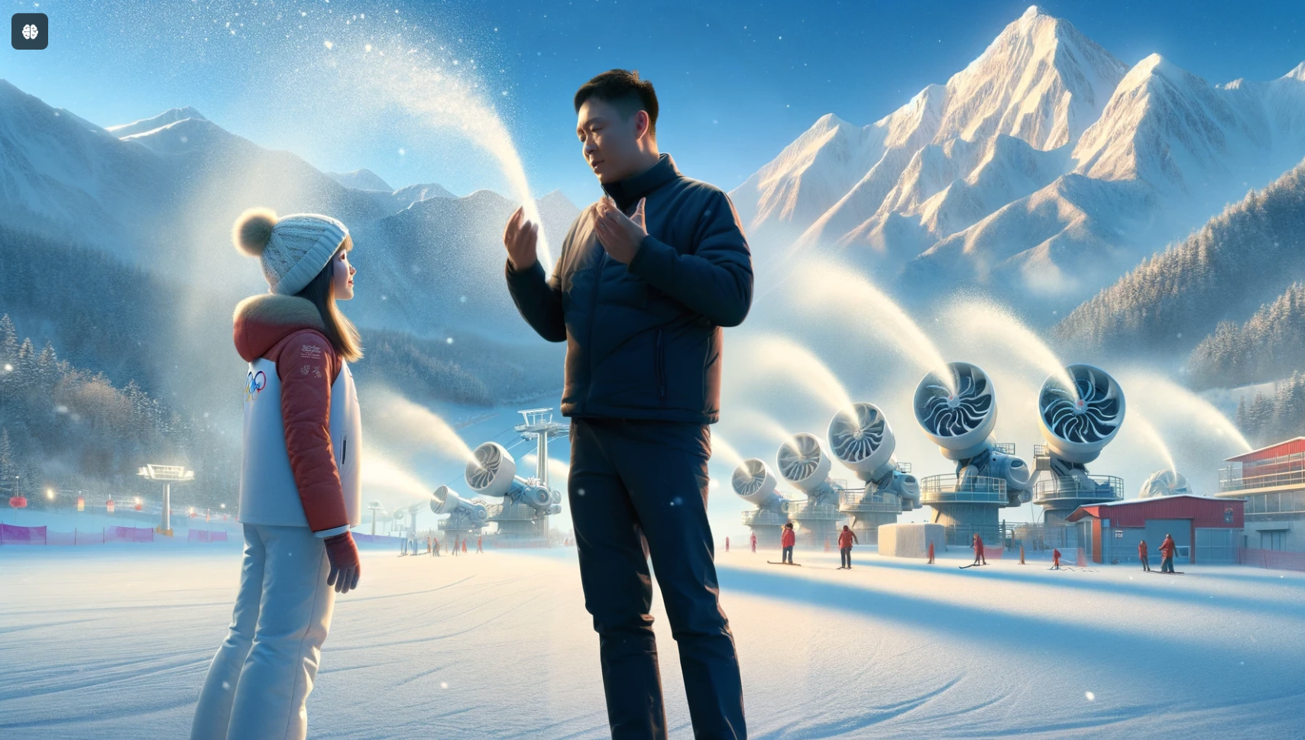
Created for visual-spatial learning style

Slide 43
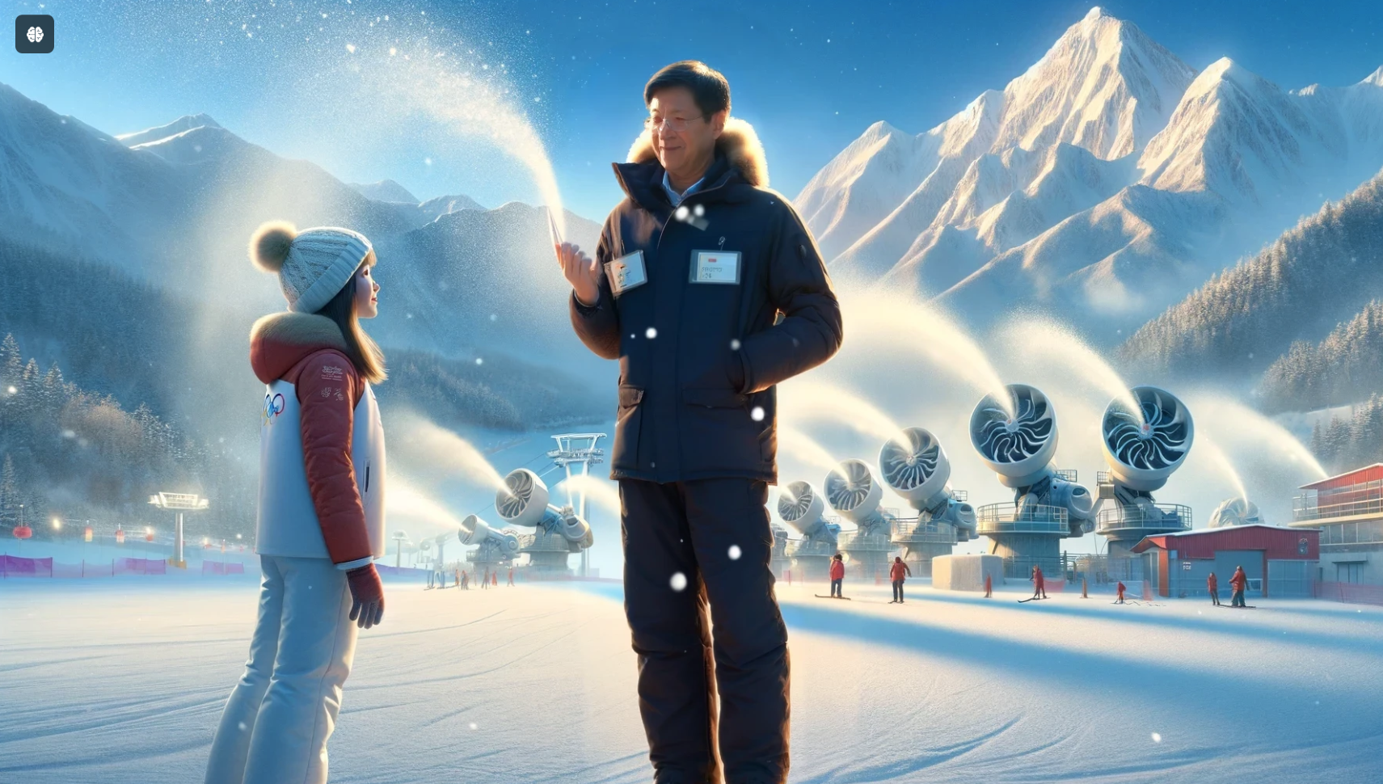
Created for visual-spatial learning style

Slide 44
Word count, POV, target audience
Please rewrite the story in 80 words from a third person point of view. The revised text will be presented to university freshmen at the beginning of their English class.
From Zero to Hero
Five days before the Beijing 2022 Winter Olympics, under Yanqing’s clear blue sky, the snow mountains glistened as snowflakes danced. An Olympic Family Assistant at the chief landing center, I was assigned to assist Mr. C, a snowmaking expert. He explained snowmaking machines and their role in creating perfect snow conditions. Fascinated by his knowledge and dedication, I felt proud to be part of the Winter Olympics. The team’s hard work paid off, and the athletes performed their best.
Notes:
翻转课堂

Slide 45
The 3rd-person-point-of-view version
Five days before the Beijing 2022 Winter Olympics, under Yanqing’s clear blue sky, the snow mountains glistened as snowflakes danced. An Olympic Family Assistant at the chief landing center was assigned to assist Mr. C, a snowmaking expert.
Mr. C explained snowmaking machines and their role in creating perfect snow conditions. Fascinated by his knowledge and dedication, the assistant felt proud to be part of the Winter Olympics. The team’s hard work paid off, and the athletes performed their best.

Slide 46
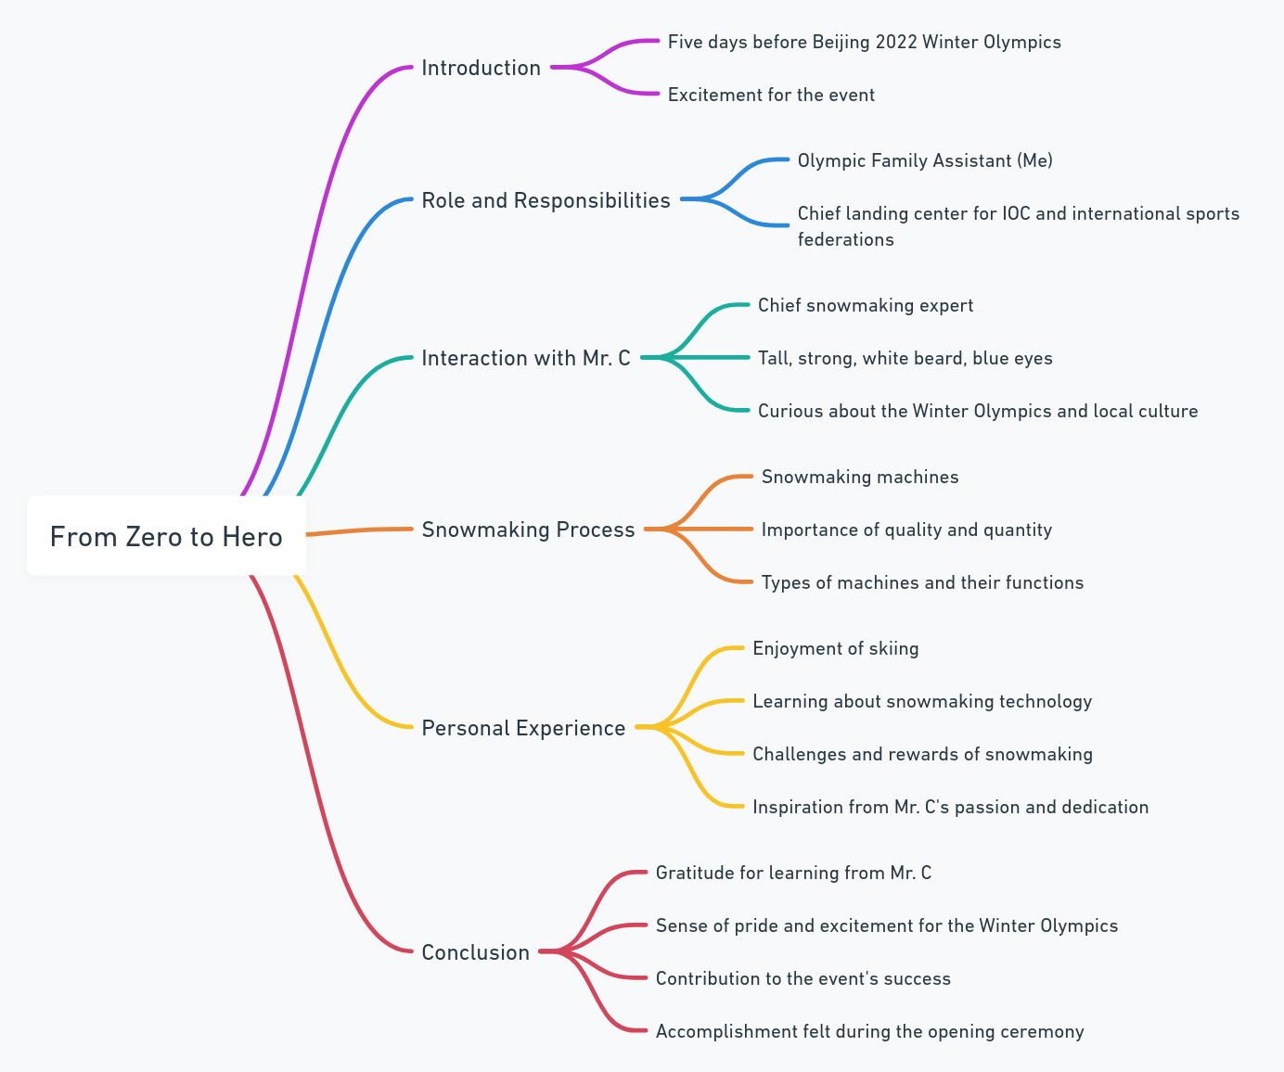
For holistic learners

Slide 47
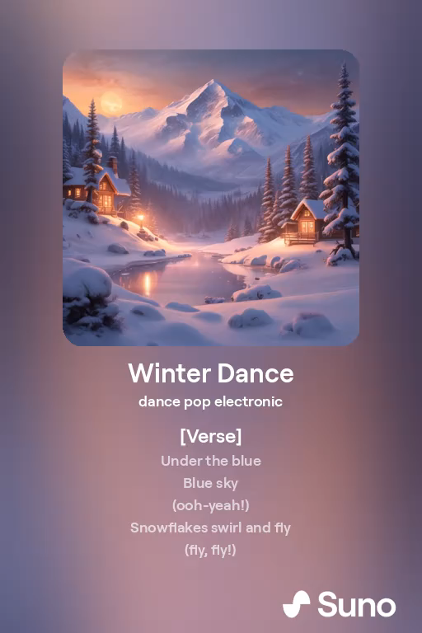
Zero to Hero Song: Winter Dance

Slide 48
Role play (with a non-L1 English professional)
Please create a 100-word role play between the student volunteer and a Norwegian snowmaking expert based on the provided text.
Student: Hallo, Mr. C, it’s an honor to assist you. How do you make snow for the Olympics?
Mr. C: Hallo, We use snowmaking machines that atomize water into tiny droplets, which then freeze into snow crystals. It’s all about getting the right quality and quantity.
Student: That’s fascinating! How do you feel about working here?
Mr. C: I feel very proud. It’s a great honor to work with talented people from around the world…..
Notes:
Student: Do you like skiing?
Mr. C: Yes, but the most important thing is to have fun and enjoy the experience.
Student: Thank you for sharing your knowledge, Mr. C.
Mr. C: My pleasure. Enjoy the Winter Olympics!

Slide 49

PromptBank
https://promptbank.unipus.cn
Over 200 ELT related prompt, all in English, resources have been made publicly available.

Slide 50
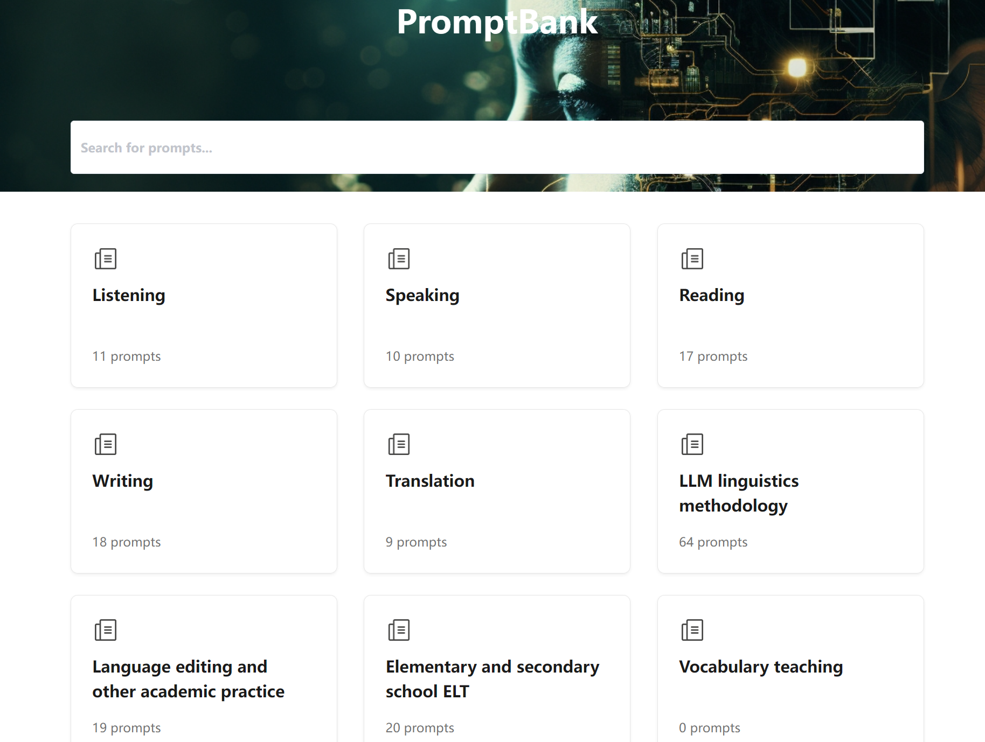
https://promptbank.unipus.cn

Slide 52
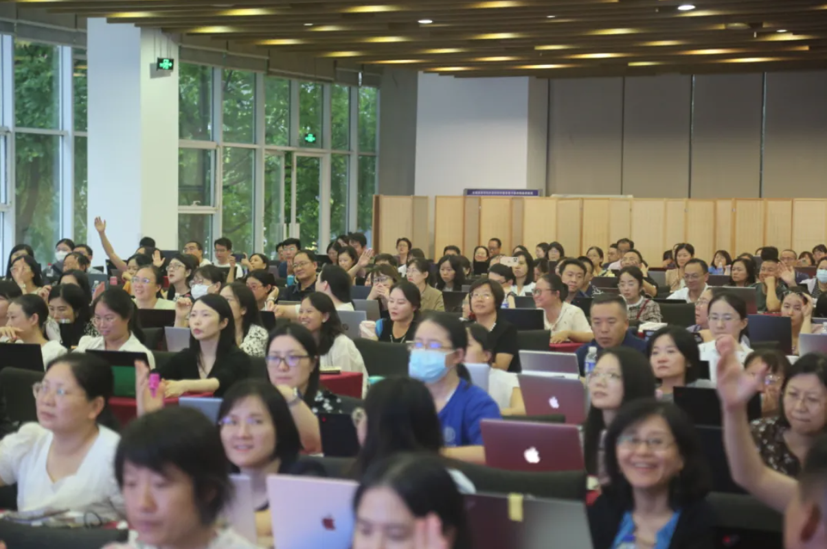
AI for College English Teachers Workshop

Slide 53
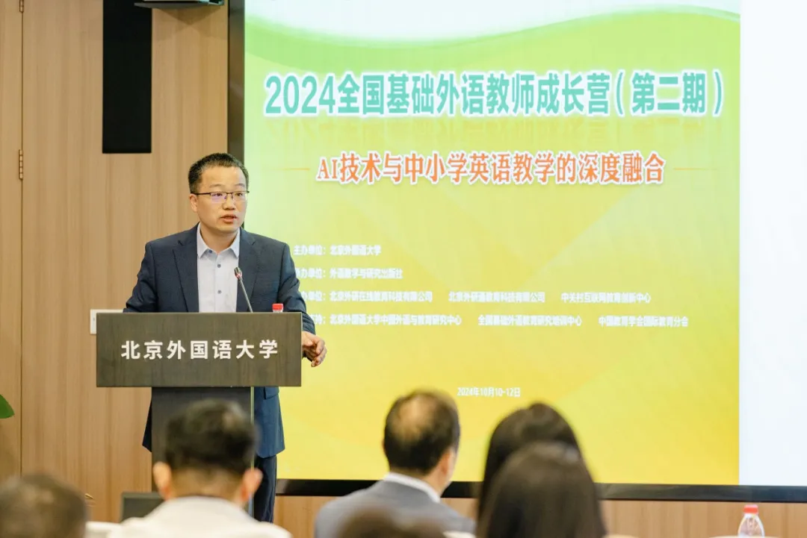
AI for K-12 English Teachers Workshop

Slide 54
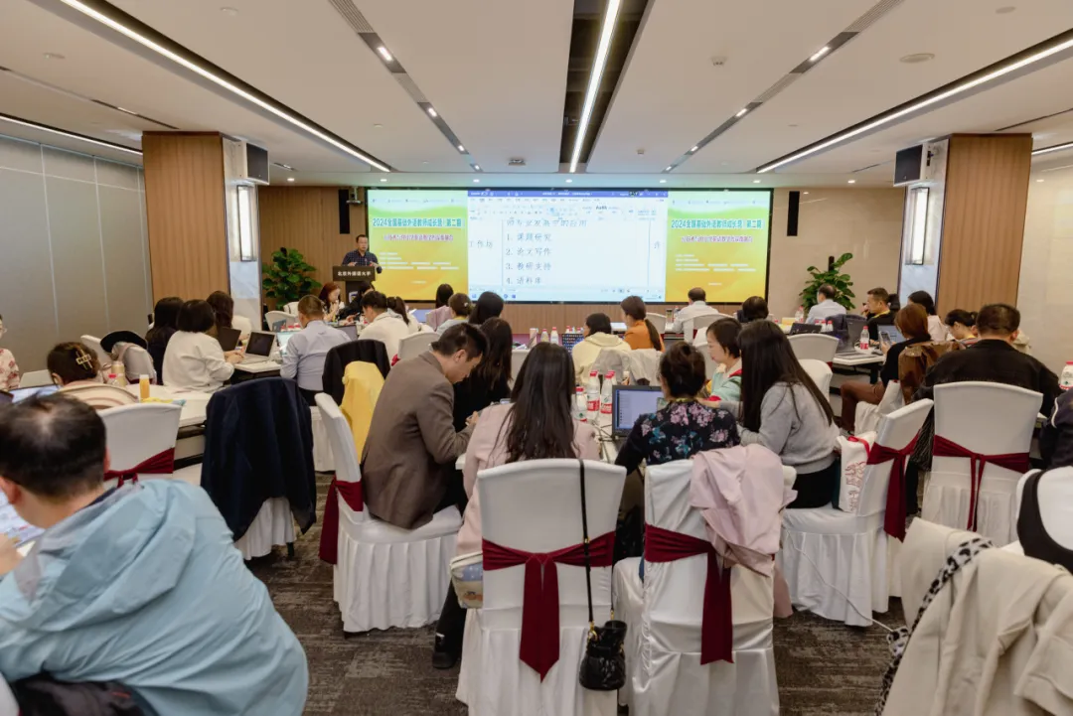
AI for K-12 English Teachers Workshop

Slide 55
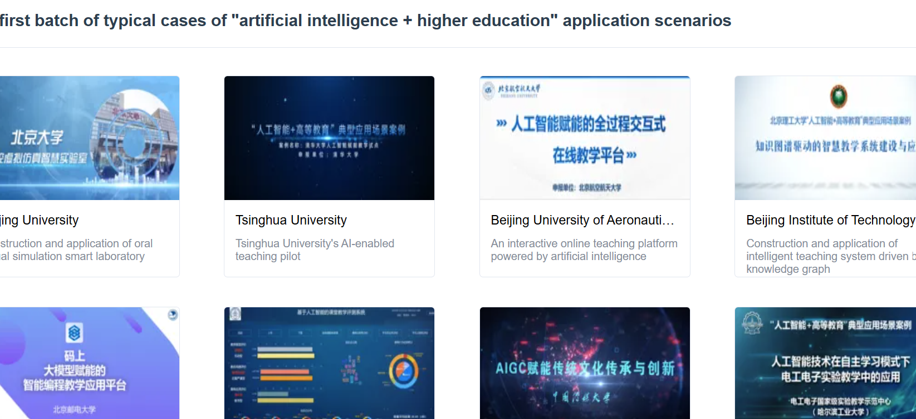
18 top university led AI-enabled edu platforms
Note: The English text in the screenshot was automatically translated using Google Translate.
Notes:
https://vtrs.hep.com.cn/#/more/ai-classic-cases

Slide 56
Note: The English text in the screenshot was automatically translated using Google Translate.

Slide 57
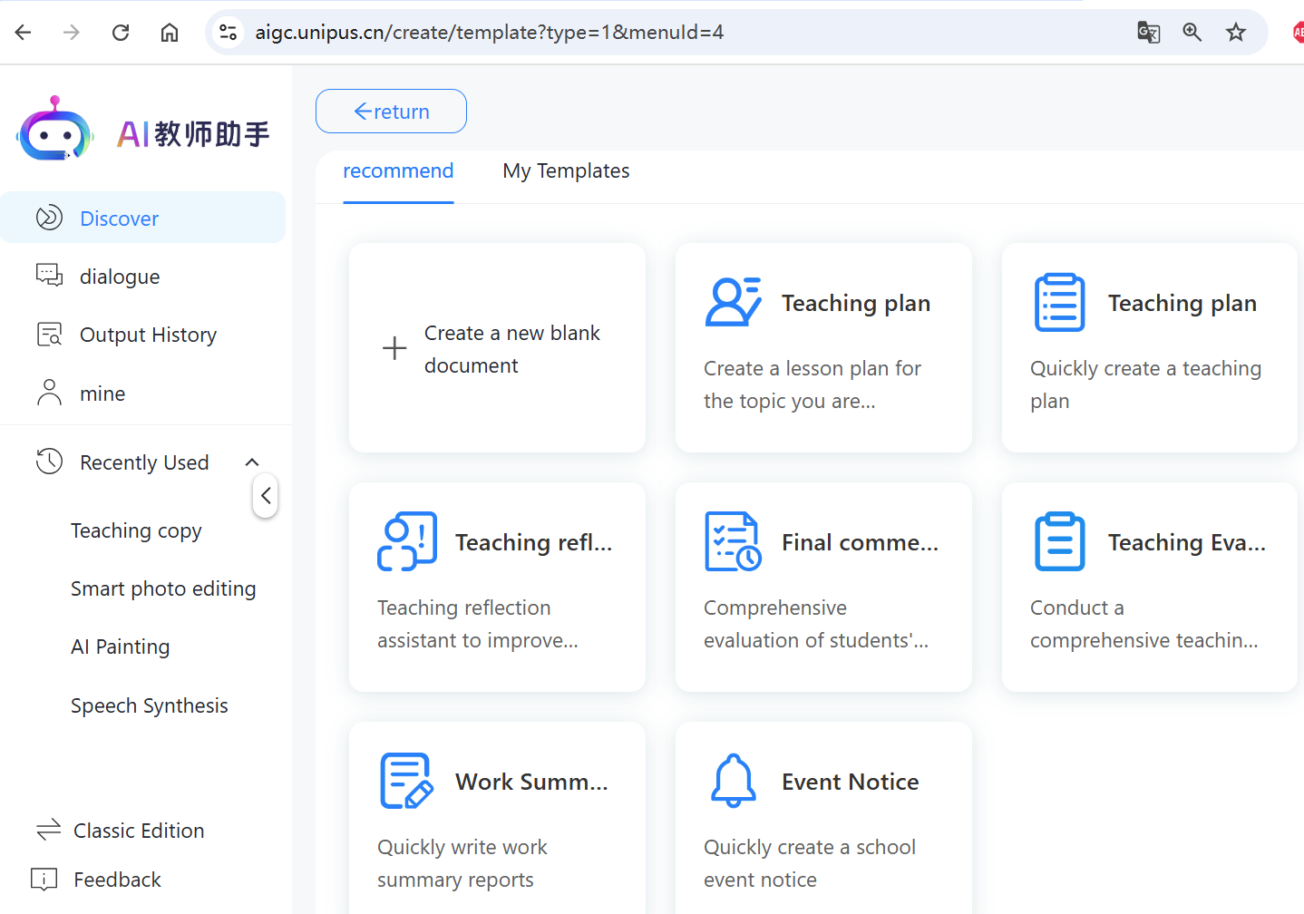
AI English teaching assistant
Note: The English text in the screenshot was automatically translated using Google Translate.

Slide 58
In this talk
AI use in education
Proposed Prompting Quotient to update teachers’ digital literacy
AI case scenarios for personalised ELT

Slide 59
Final thoughts: Student AI literacy
The future is digital, and our children are AI natives.
We hope that our children not only inhabit the future but shape it.
ELT teachers need to guide the students to become creators, not just consumers, of technology.
How can we prevent students from over-relying on AI and using it to cheat?

Slide 60
Final thoughts: Some good practices
In some Chinese universities and schools,
Students’ AI use is encouraged to support learning.
Their weekly AI assisted assignments are not graded.
Required to submit interaction log or interaction recording with AI chatbots.
Students are required to take their mid-term and final exams in class without the help of AI.
Enhances human-AI interaction and critical thinking ability.

Slide 61
Final thoughts: Not mentioned but as crucial
Training on hallucinations, bias, ethics, safety, and privacy in AI applications is a prerequisite for all teachers and learners.

Slide 62
Final thoughts: A look into the near future
AI is not the future; it is already here.
Human-AI tutor collaborative classroom
Be prepared and... Fasten your seatbelts!
The prompting quotient remains essential for effectively managing an AI-powered ELT classroom.

Slide 63
